Slide 1
Project aim and outline
Aim: To learn more about web scraping.
Outline:
-> Scrape game titles from the IGN website.
-> Scrape corresponding game data from Steam platform.
-> Explore data using jupyter notebook and Pandas.

Slide 2
Web scraping with Selenium
Selenium is web browser automation tool. It can handle dynamic web page elements e.g., infinites scrolling.
1. Open IGN webpage and scroll. Scrape game titles.
2. Clean broken game tiles.
3. Open Steam & scrape game data from titles.
4. Clean data in jupyter notebook and pandas.

Slide 3
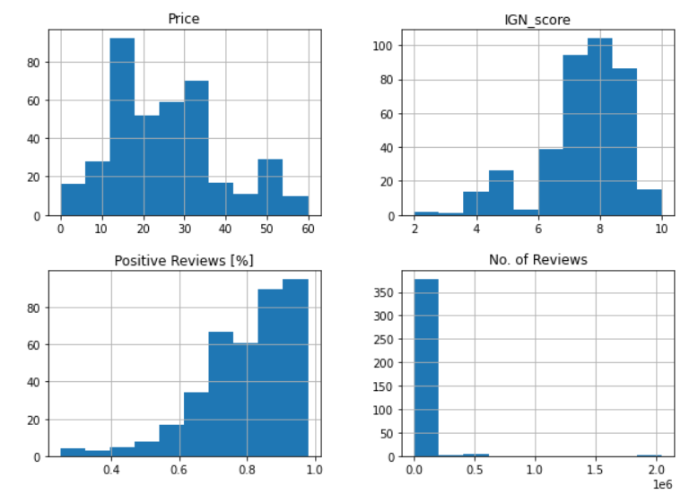
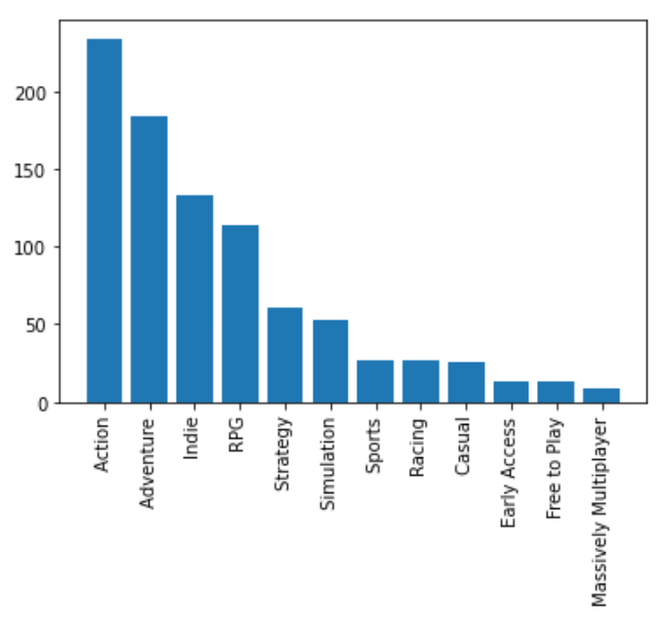
Exploring game data: Distributions
Histograms of game data: Price [£], IGN Score, Positive Steam reviews [%], & No. of reviews.
Frequency of game genres
Genre Frequency
Genre Frequency

Slide 4
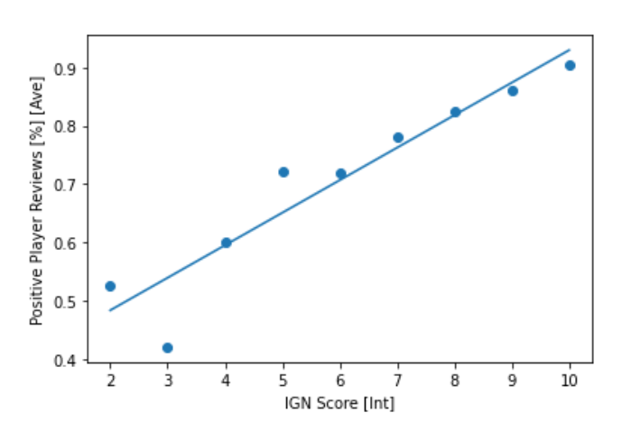
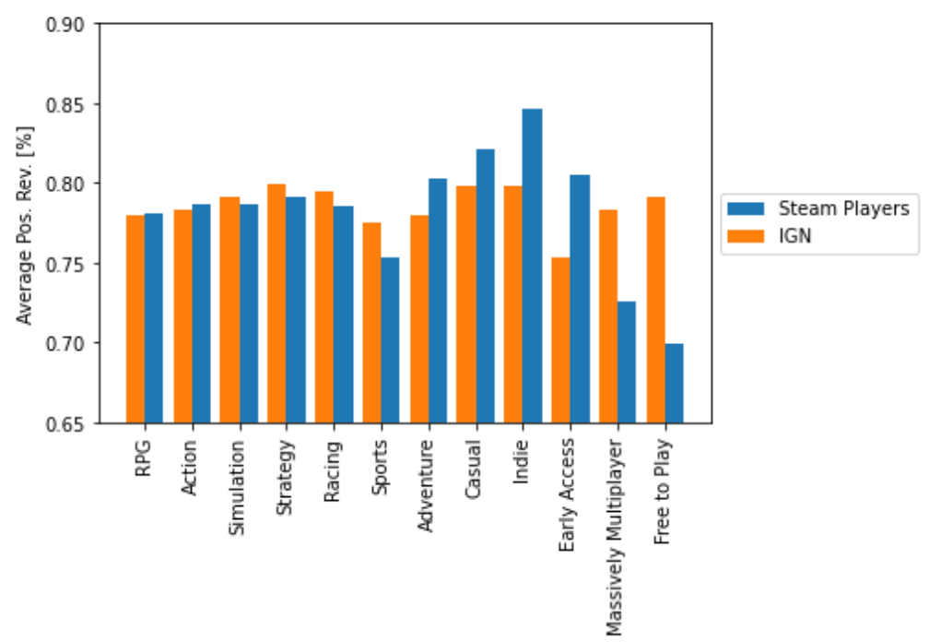
Exploring game data: Players VS IGN
Linear regression relation between positive player review [%] and IGN review score
Scaled Comparison between Steam player and IGN positive review [%]

Slide 5
Conclusions overview
-> Selenium can be used to scrape data from webpages with dynamic elements.
-> It is very helpful to know what your using the data for before you scrape it.
-> Scaped data will require lots of cleaning. Manual cleaning can take up a lot of time.
-> Keep as much data as possible. Likely I could have kept some of the dropped data.

Slide 6
Please see Jupyter notebooks for detailed explanation of how data was scraped cleaned and, explored.
This was a brief summary.

